Slide 1


Apache Zeppelin Notebook
Presented By:
James Kocher
Apoorva Shukla
Yue-Ru (Norton) Li
Date: 03/27/2020
Logo citation: https://www.nobleprog.com/apache-zeppelin-training, https://zeppelin.apache.org/assets.html

Slide 2
About Apache Zeppelin
Web based Notebook, Interactive data analysis support
Support: Scala (Apache Spark), Python(Apache Spark), SparkSQL, Angular, Shell
Focus on Enterprise users:
Key Feature: Data Analysis and Visualization

Slide 3

Multiple language backend

Slide 4
Comparison Apache Zeppeline v.s. Jupyter Notebook
 | Apache Zeppeline | Jupyter Notebook
Community | small user population | large user population
Configuration | a separate interpreter configuration page | a little un-elegant
Extension | less extensions available | more extensions available
Installation | Decompress tarball and run server, for more feature, built it from the source | simple anaconda Install
Kernels | Large list, more than 85 of supported engines | 20 supported engines
References: https://analyticsindiamag.com/jupyter-vs-zeppelin-a-comprehensive-comparison-of-notebooks/

Slide 5
Contrast against Jupyter Notebook
 | Zeppeline | Jupyter Notebook
Appearance | allow user to combine multiple paragraphs of code in Python in one single line | not allow
Multi-User Capability | Yes | Not Support by default, use JupyterHub
Plotting of charts | Multiple interpreters in the same notebook to plot charts | Zero charting options, use existing charting libraries
Report Describing | Interactive form and visualization results in a faster way, more accurate and easily accessible to end users | Less choice and longer processing time
Security | Flexible security configuration | No privacy configuration
References: https://analyticsindiamag.com/jupyter-vs-zeppelin-a-comprehensive-comparison-of-notebooks/

Slide 6
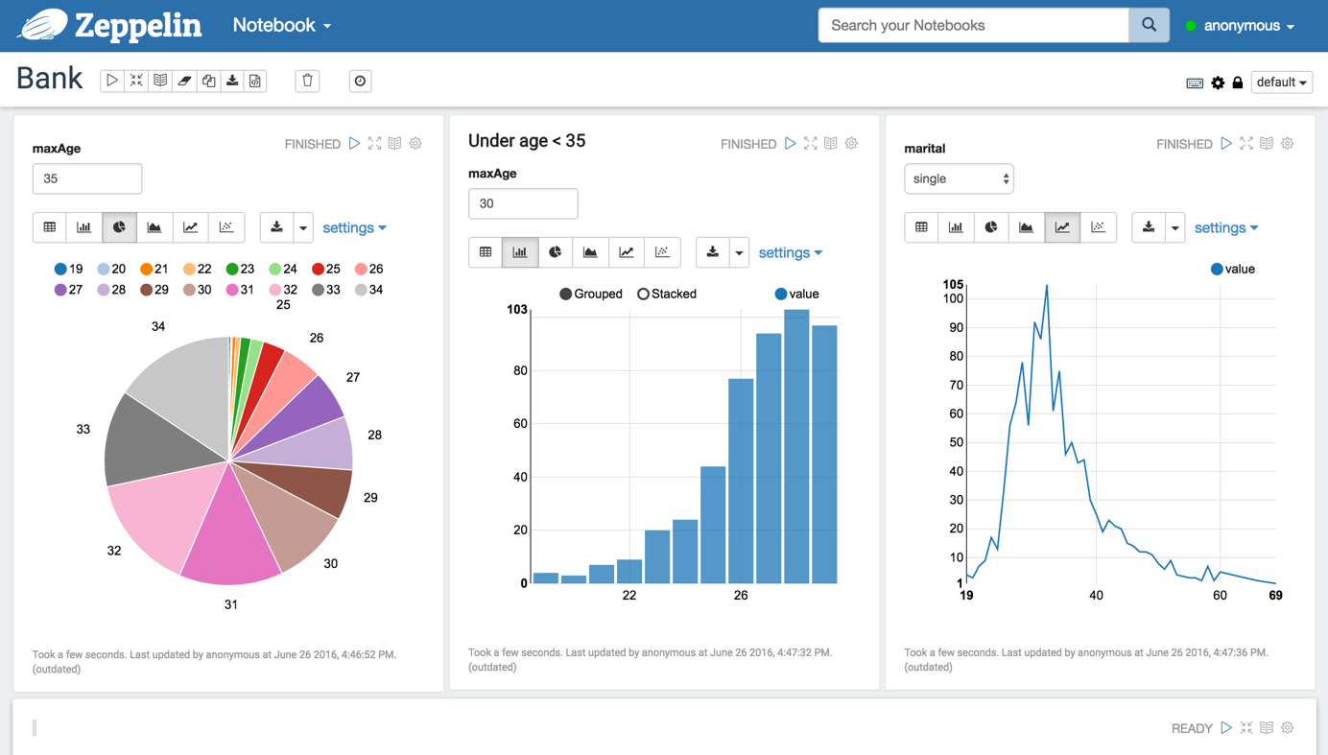
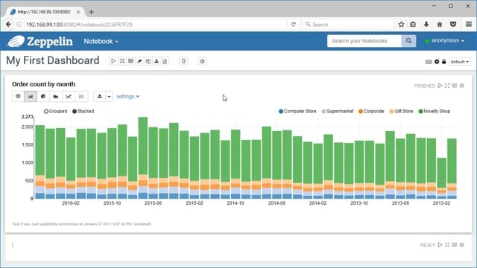
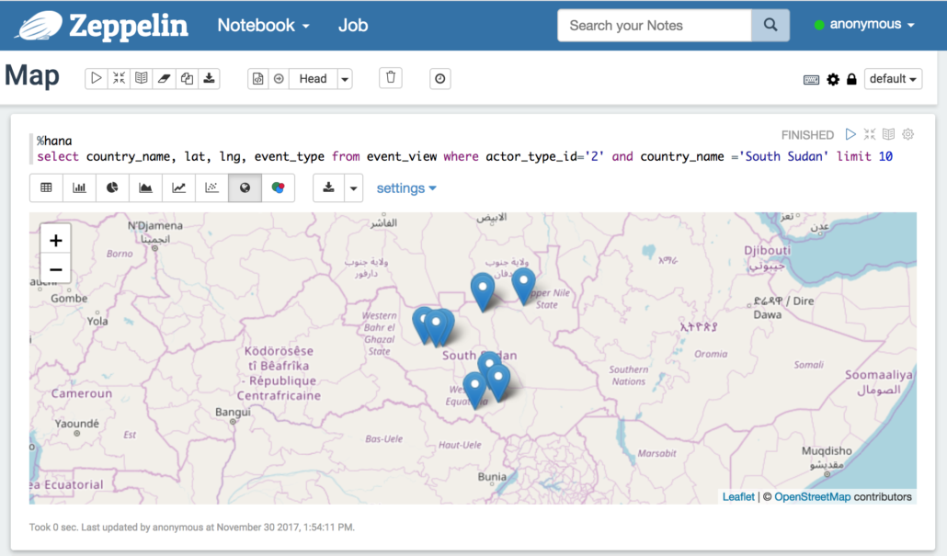
Zeppeline:
Easy and safe way to make data interactive together

Slide 7
Thank You!
Sensitive data
Privacy of data
Logo citation: https://www.nobleprog.com/apache-zeppelin-training
https://zeppelin.apache.org/assets.html

Slide 8
bedankt
cảm ơn bạn
Danke
hvala
תודה
Σε ευχαριστώ
Thank You
Question?
谢谢
ありがとう
merci
mulţumesc
شكرا لك
ačiū
obrigado
감고맙습니다사합니다
salamat
gràcies
Спасибо
terima kasih
Благодаря ви
grazie
धन्यवाद

